Slide 1
Automatic Flat Colouring
Shuo Wen

Slide 2
Content
Intro
Method
Our work
Next steps

Slide 3
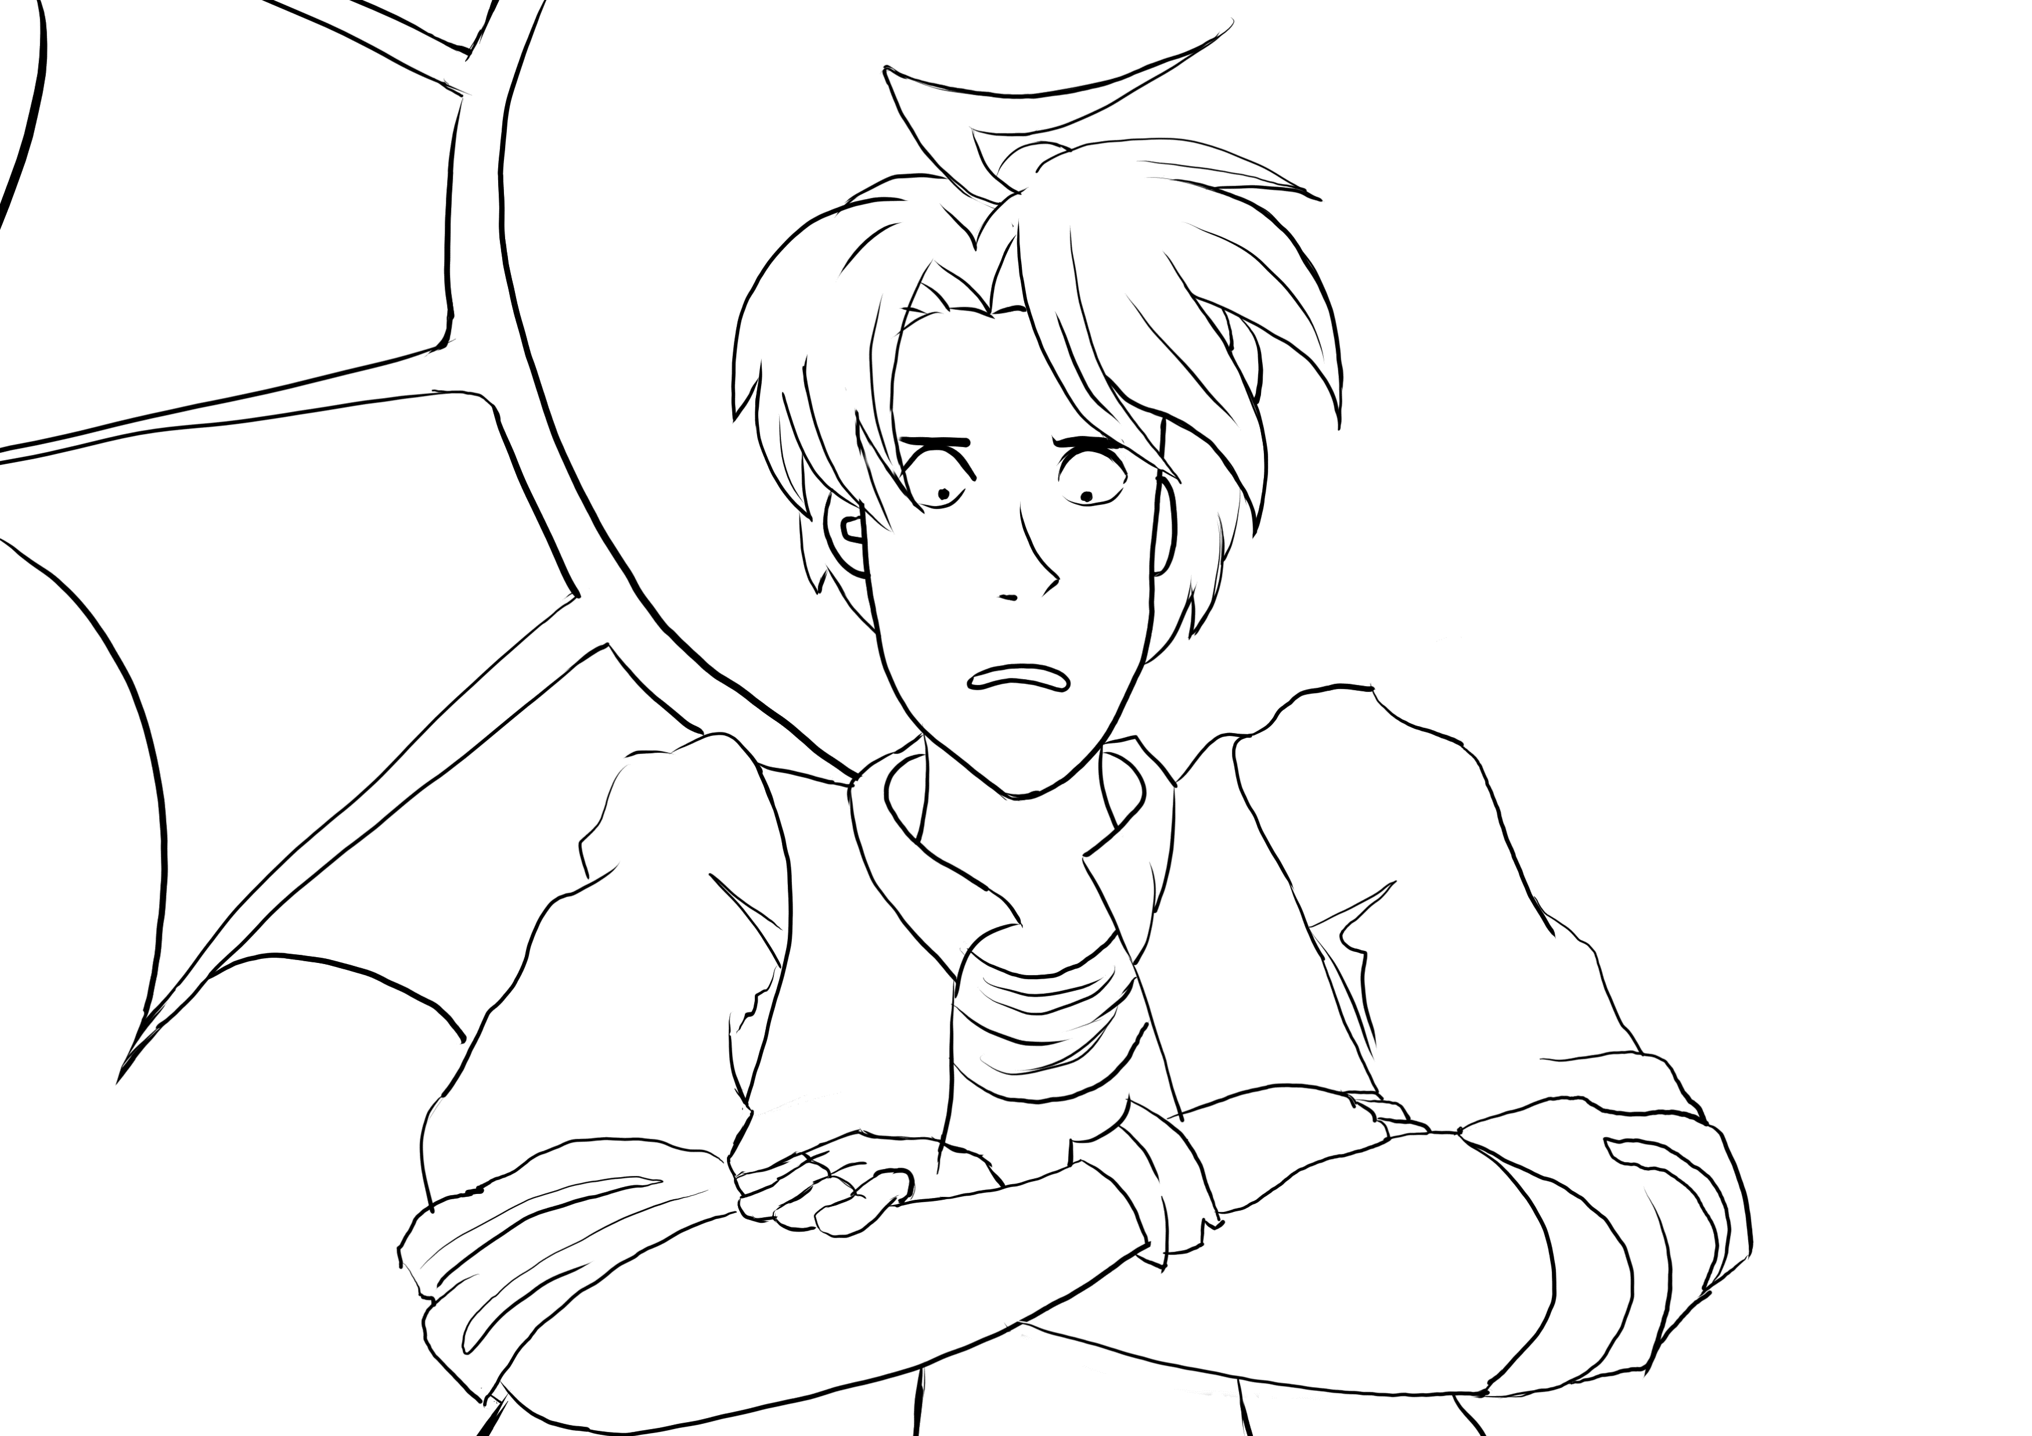
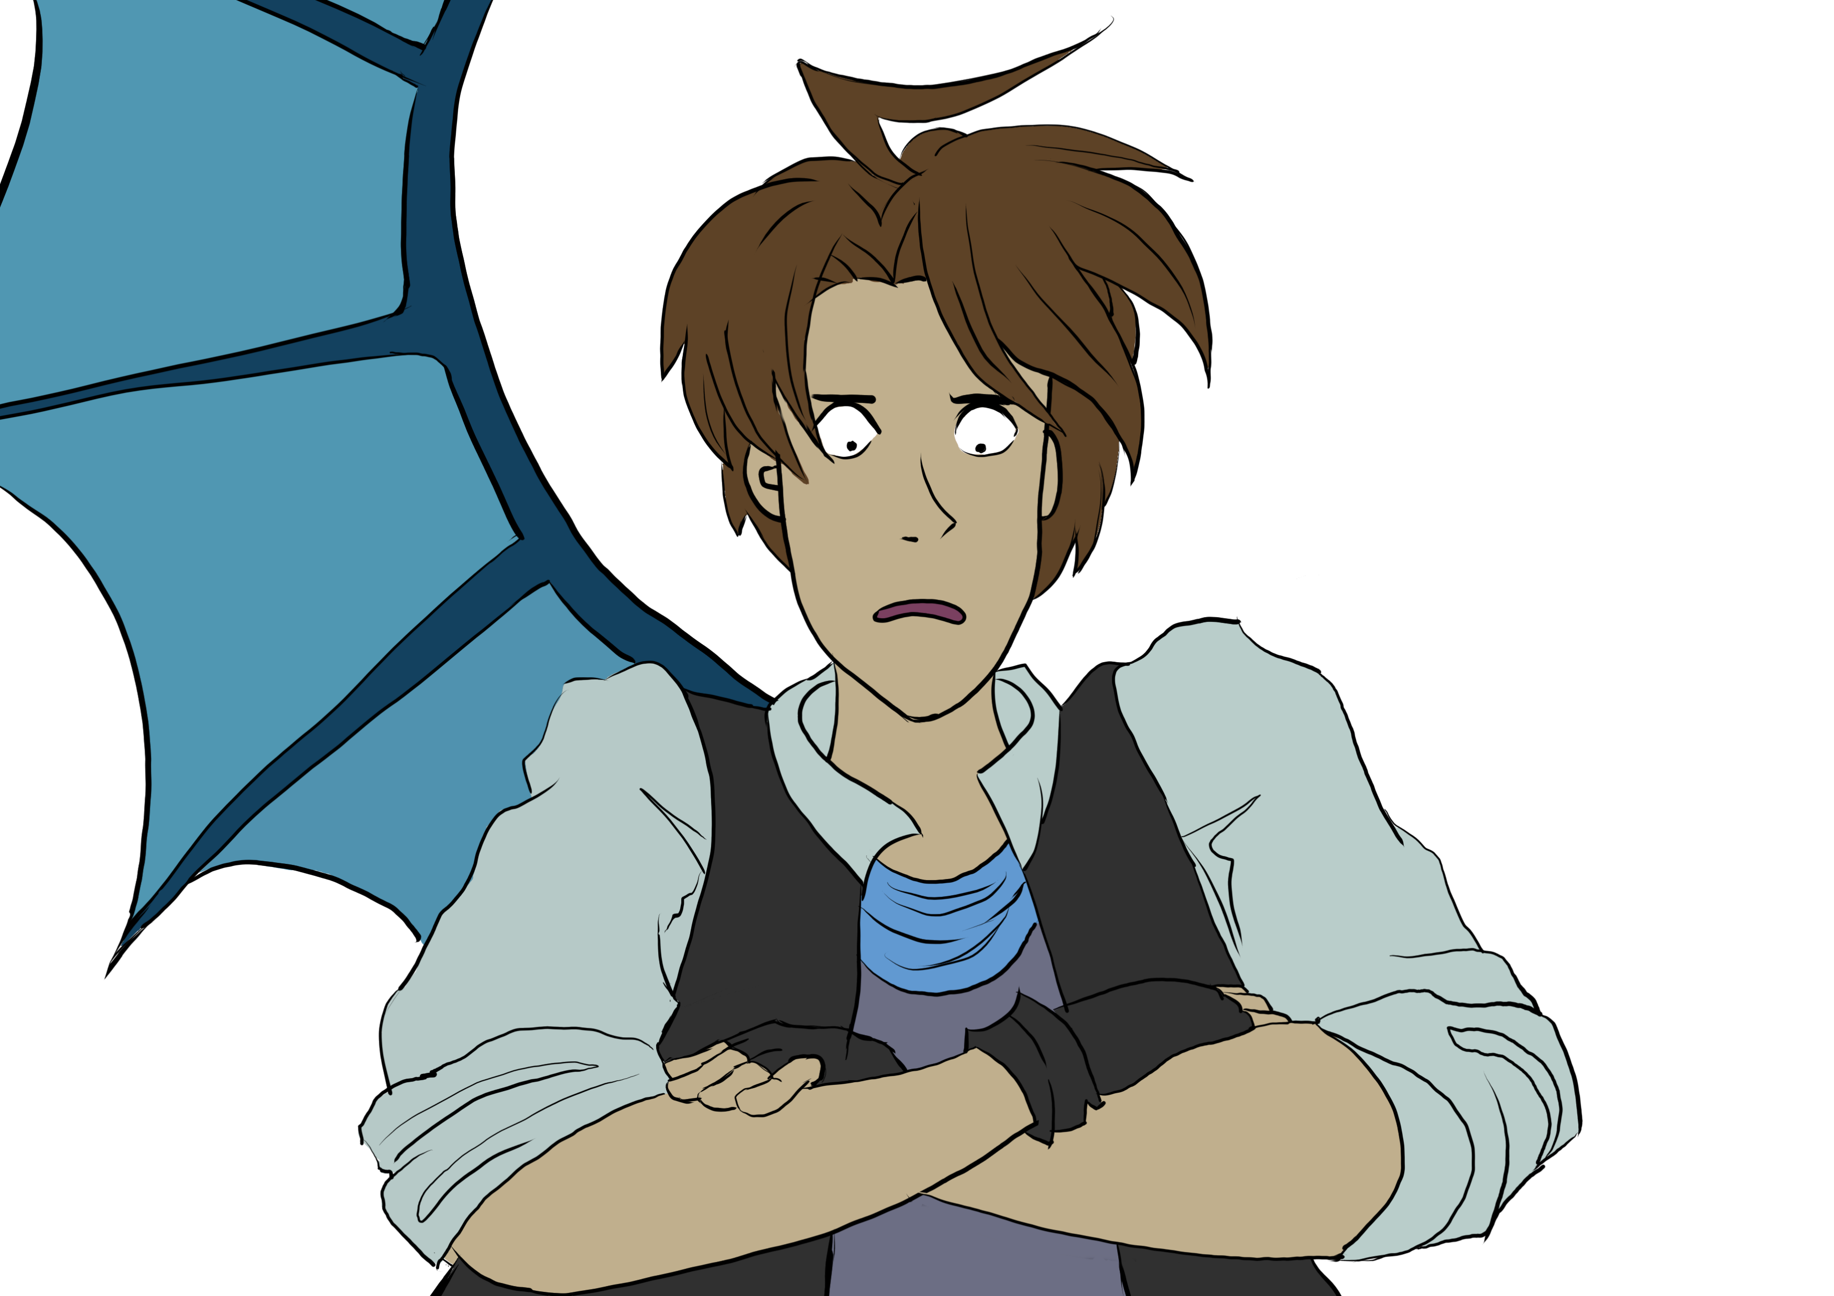
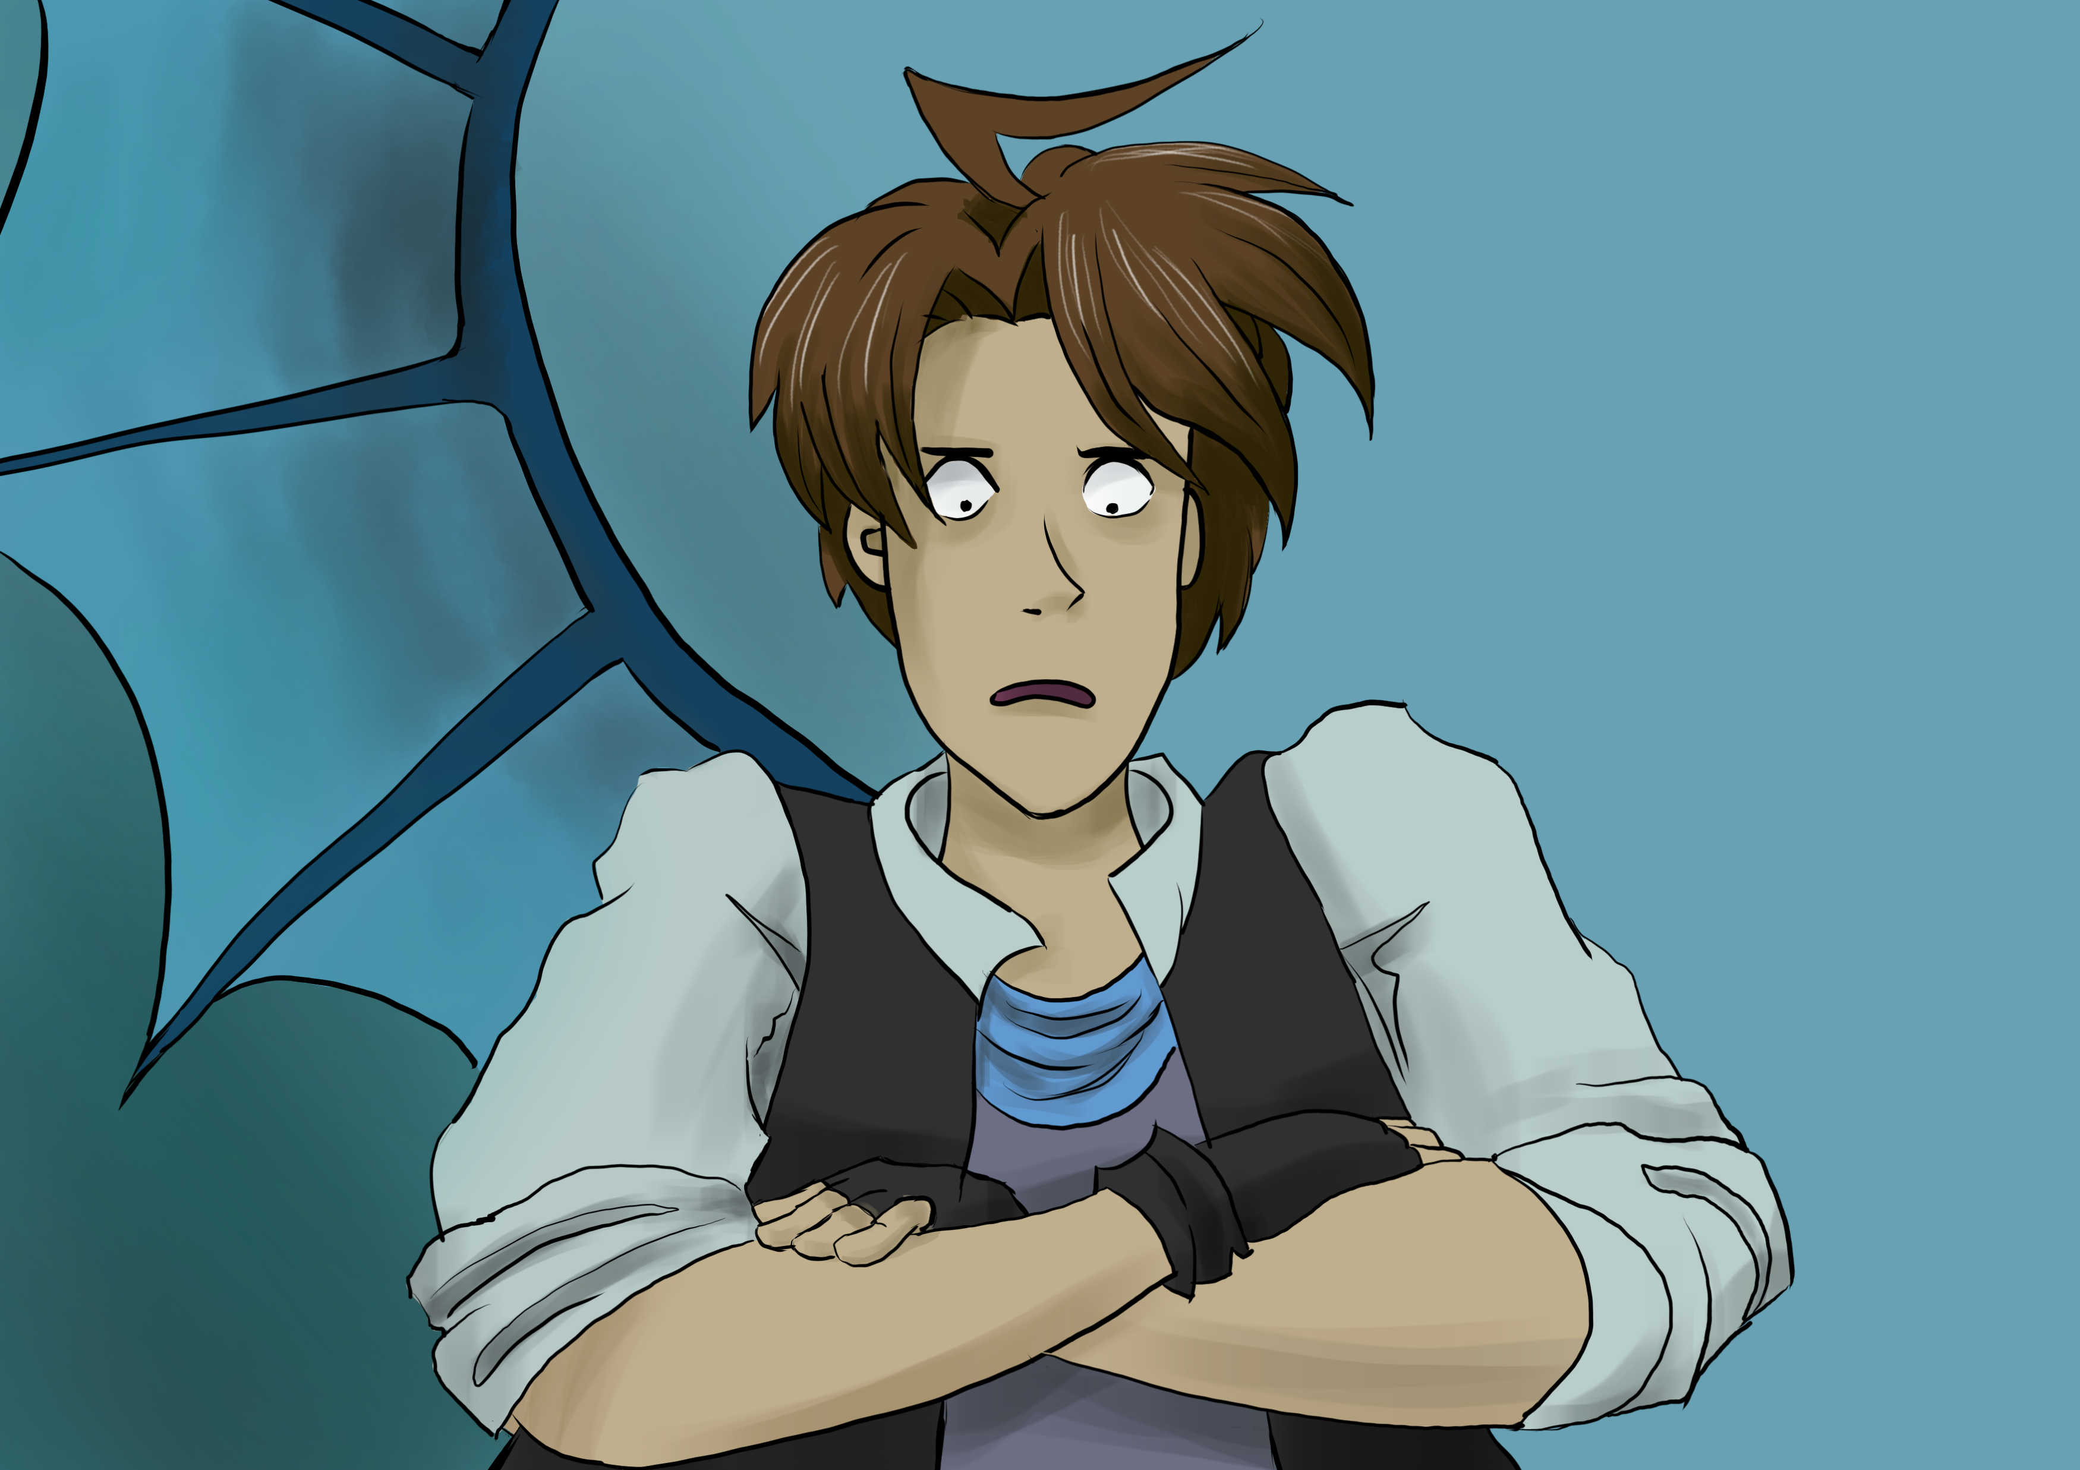
Comic making processing
Line-art
Flat colouring
Shadows and other effects added
Flat colour¹: Any area of a painting that has an unbroken single hue and value.
1: http://www.encyclo.co.uk/local/21274

Slide 4
Flat colour: Any area of a painting that has an unbroken single hue and value.
We need to:
Divide the image into regions.
For line-art, we only need to close the lines.
We need to:
Find out the corresponding color for each region.
Implement:
The “Closure of the strokes” step in paper¹: A Fast and Efficient Semi-guided Algorithm for Flat Coloring Line-arts.
(Has been implemented in GMIC².)
Implement:
Train and get the generator which could generate the color map.
(Generator we use: Attention U-net.)
1: https://hal.archives-ouvertes.fr/hal-01891876/document
2: https://gmic.eu/
Notes:
So two steps are needed to achieve flat coloring
First, we need to
Fortunately, there is an algorithm. And it is implemented in GIMC, and open source.
Then we need to assign color for each region.
At this step, we need a generator, and the g we use is

Slide 5
Content
Intro
Method
Our work
Next steps

Slide 6
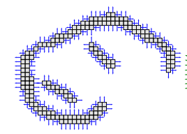
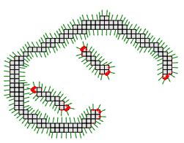
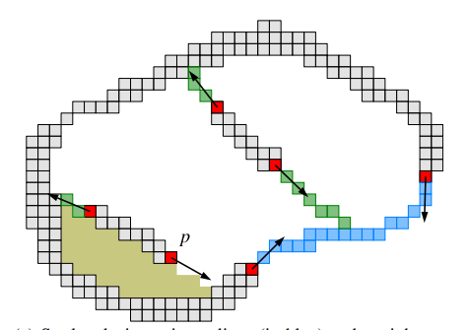
Closure of the strokes¹
Calculate the normals of the line-art
Calculate the curvature from the normals and set the points with large curvature as the key points
Stroke closing using splines (in blue) and straight segments (in green)
1: https://hal.archives-ouvertes.fr/hal-01891876/document
Notes:
The algorithm for closing the lines is shown here.
In general,

Slide 7
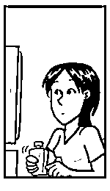
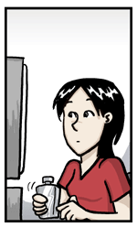
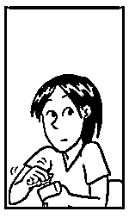
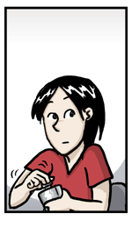
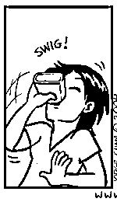
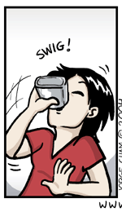
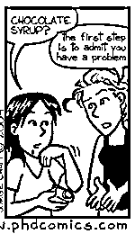
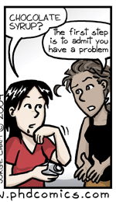
Network – Image to Image
Generator
To make the generator knows how to fill the colors:
1. For each different comic series, different networks need to be trained.
2. Only works for a long serial comic since a big dataset is needed.

Slide 8
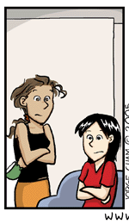
Network - Style transfer
Reference Image
Generator
The generator knows how to fill the colors from the reference image.
1. Only one network is needed.
2. Work for both long and short serial comics.
Notes:
Another choice is style transfer network.
In addition to the line art, a reference image is also input into the network.
So, this network is what we choose.

Slide 9
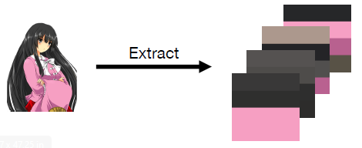
Network – Attentioned Deep Painting¹
Reference Image
1：https://github.com/ktaebum/AttentionedDeepPaint/blob/master/poster.pdf

Slide 10
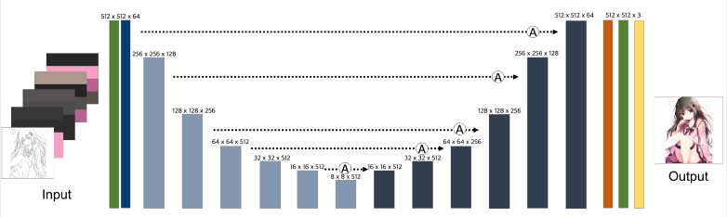
Network – Attentioned Deep Painting¹
Reference Image
Generator: Attention U-net
1：https://github.com/ktaebum/AttentionedDeepPaint/blob/master/poster.pdf

Slide 11
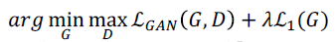
Network – Attentioned Deep Painting¹
Reference Image
Generator: Attention U-net
Loss function:
Reconstruction loss
GAN loss
(Discriminator: CNN)
1：https://github.com/ktaebum/AttentionedDeepPaint/blob/master/poster.pdf

Slide 12
Content
Intro
Method
Our work
Next steps

Slide 13
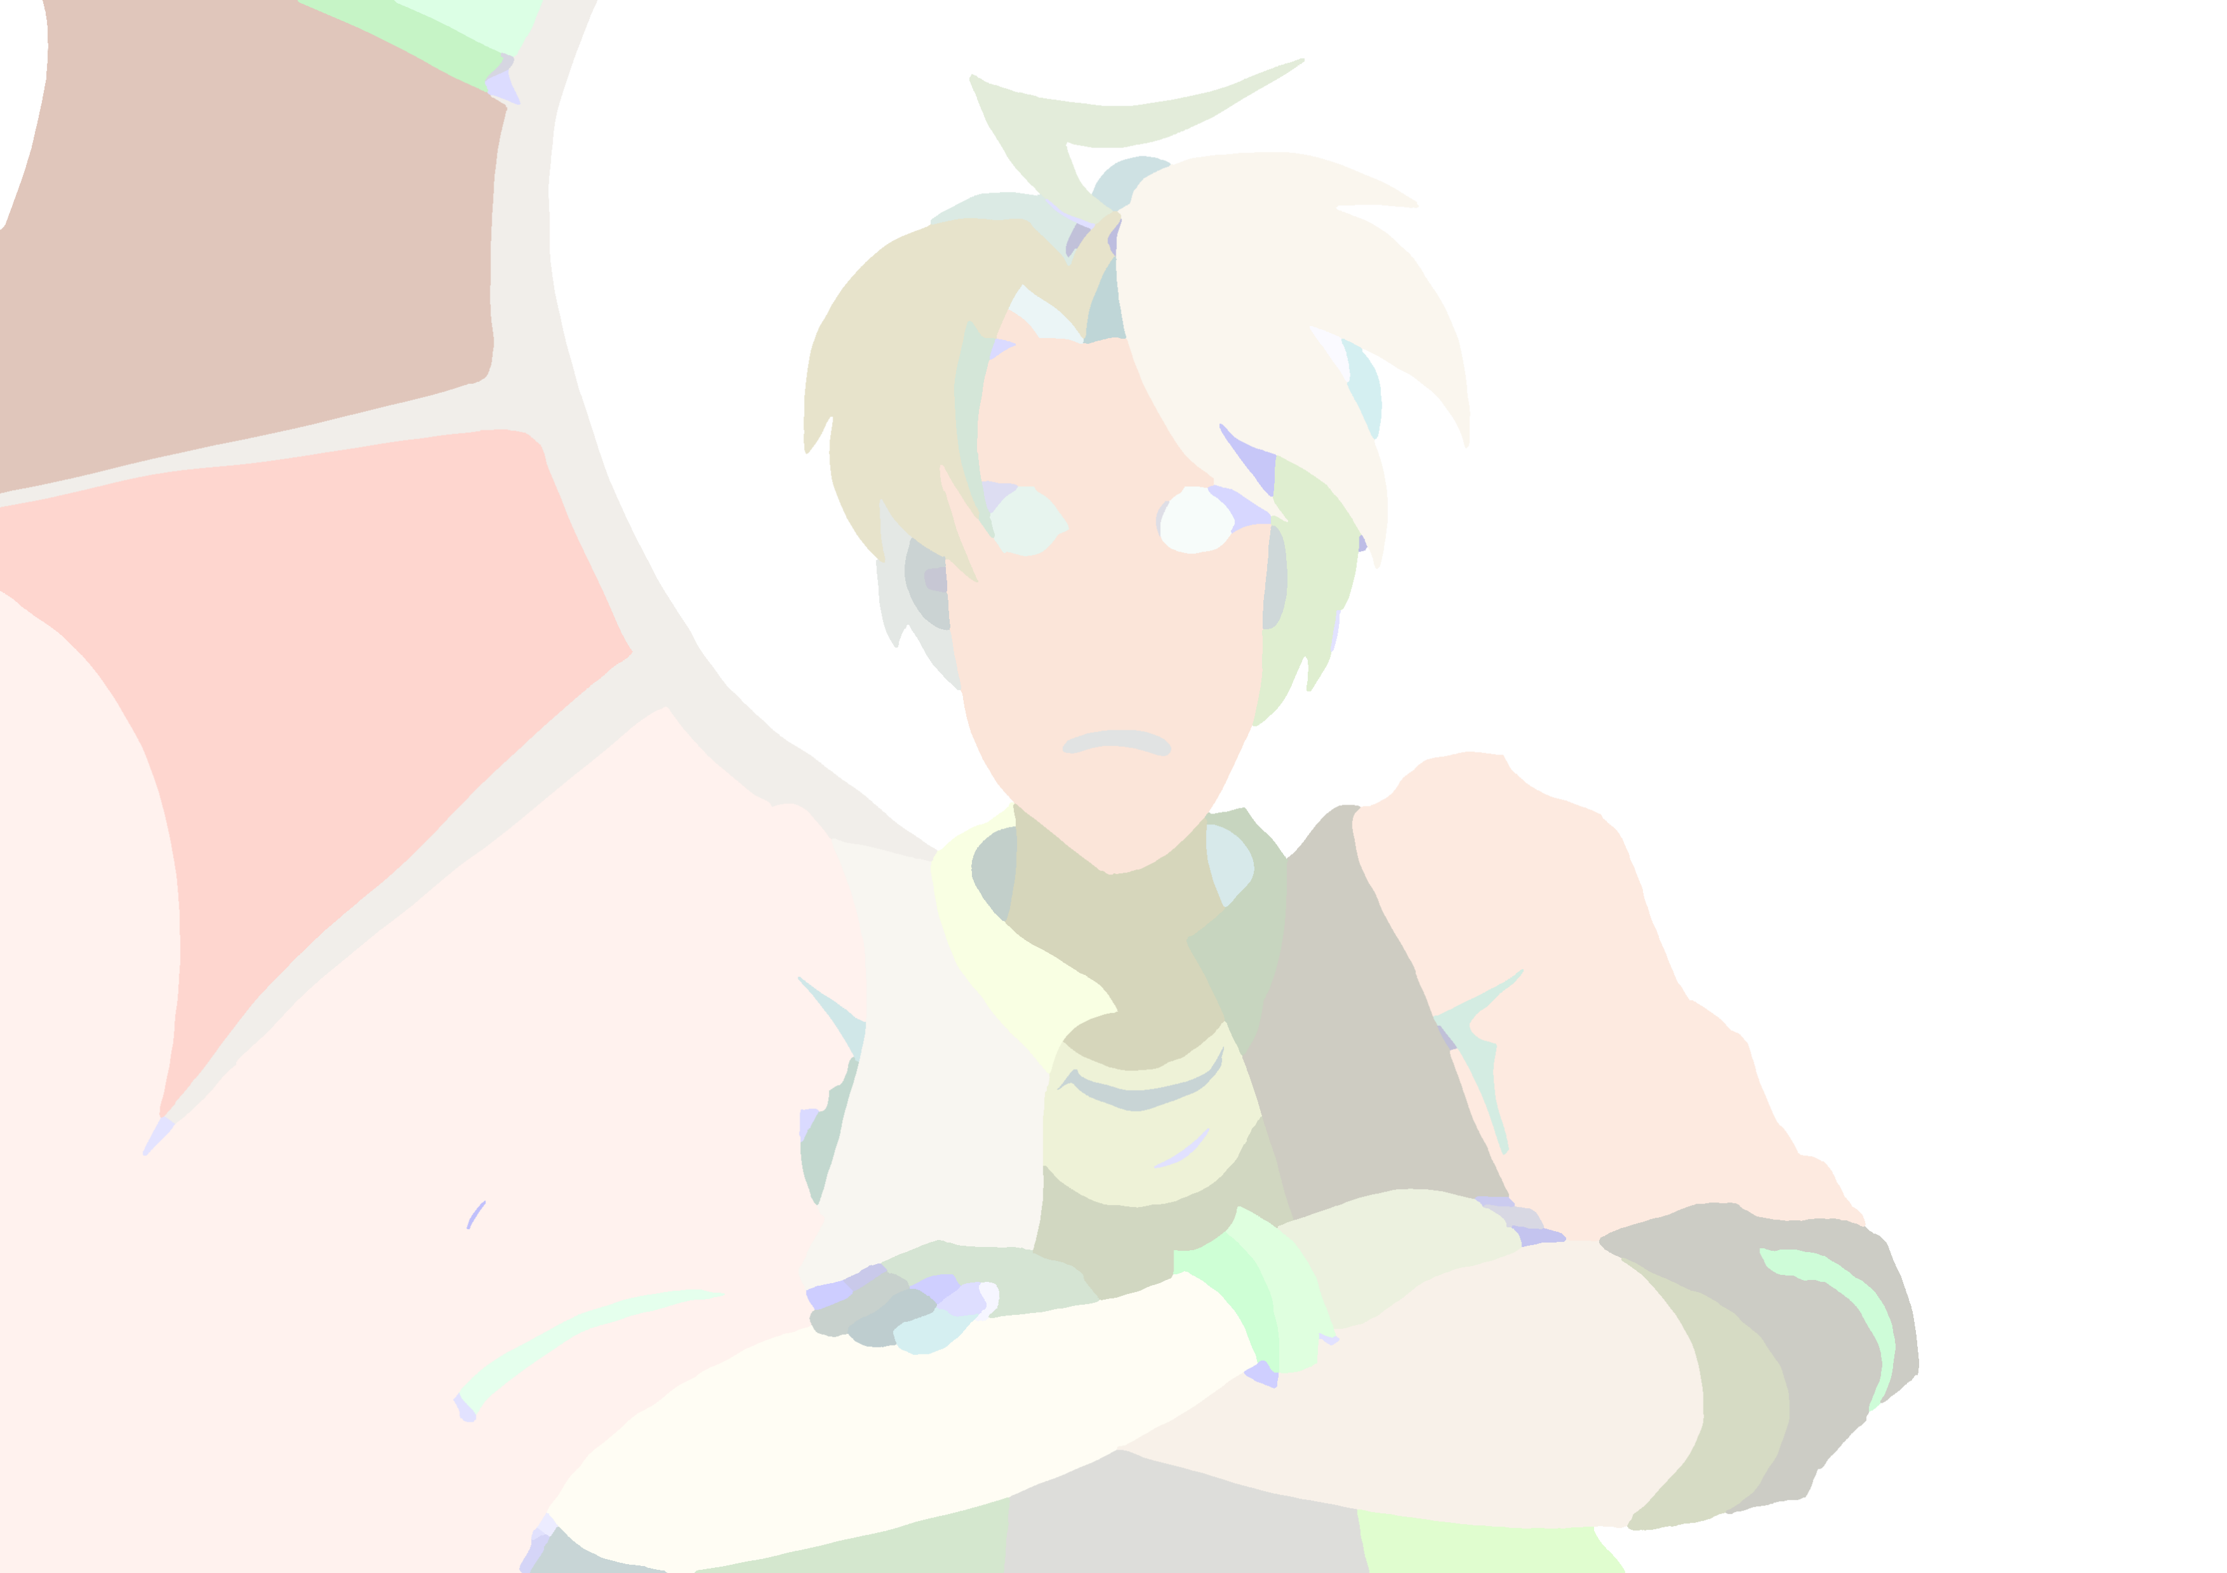
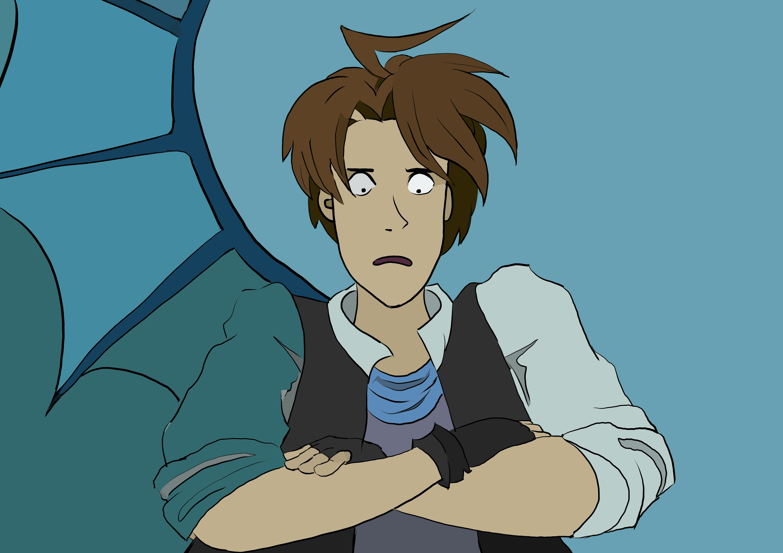
Stroke closing algorithm from GMIC¹
Intermediate result from function
fx_colorize_lineart_smart of GMIC
Line-art
Regions
Color map
Output
Ground truth
1: https://gmic.eu/

Slide 14

Stroke closing algorithm from GMIC¹
More regions than we expected:
No influence but only when we have a perfect colored image.
Less regions than we expected:
Cause several connected regions to be the same color.
Line-art
Regions
Color map
Output
1: https://gmic.eu/

Slide 15
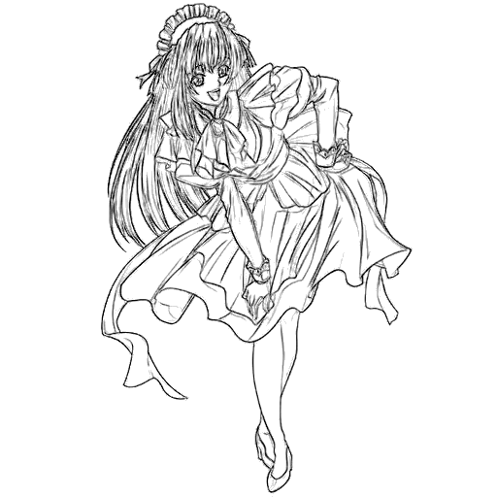
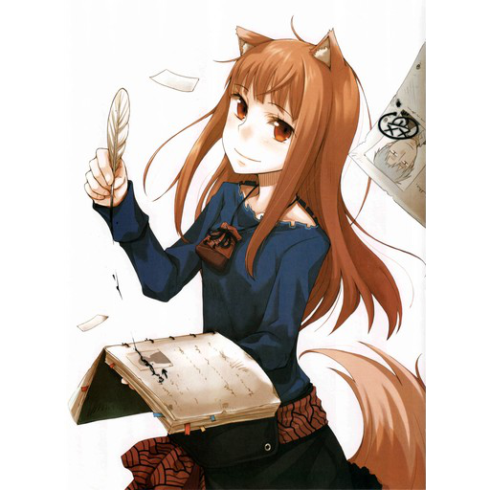
Network – dataset of ADP
Dataset of ADP: sketches colored image with shadow and other effects
What we need: line-arts image with only flat color

Slide 16

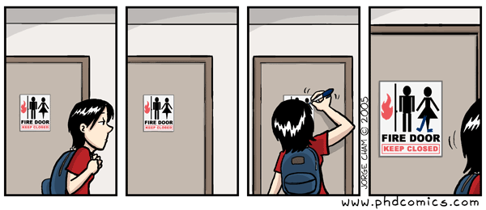
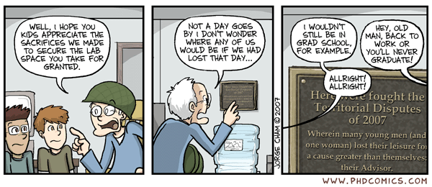
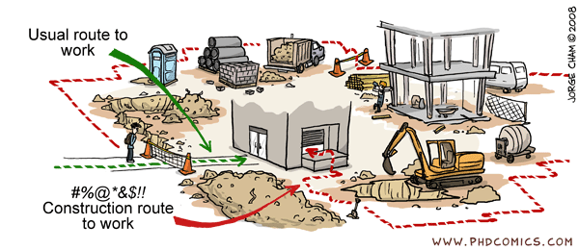
Network – created dataset¹
1: http://phdcomics.com

Slide 17
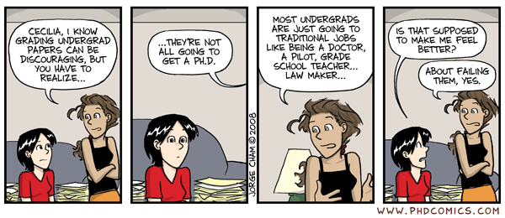
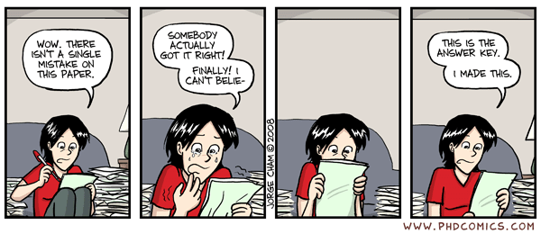
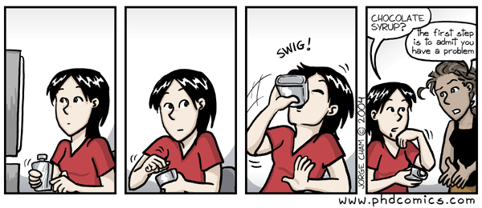
Network – created dataset¹
1: http://phdcomics.com

Slide 18
Network – created dataset¹
1: http://phdcomics.com

Slide 19
Network – created dataset¹
1: http://phdcomics.com

Slide 20
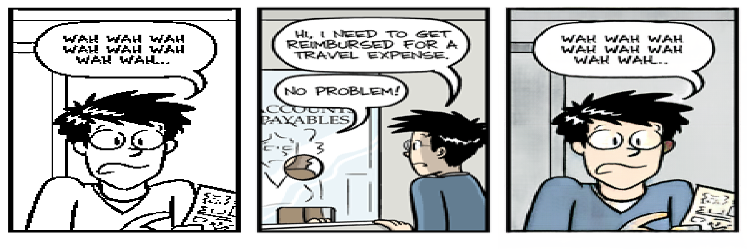
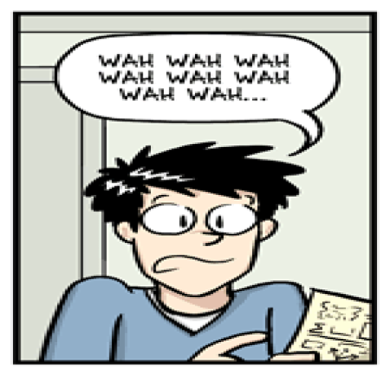
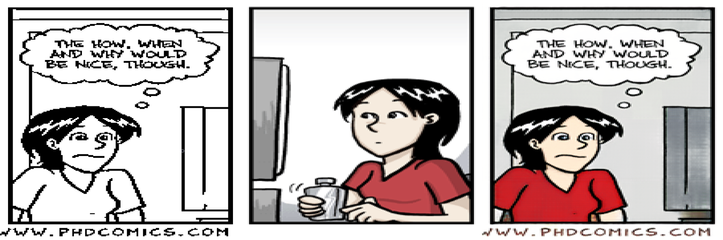
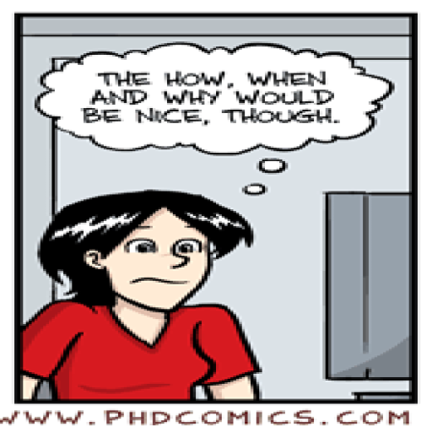
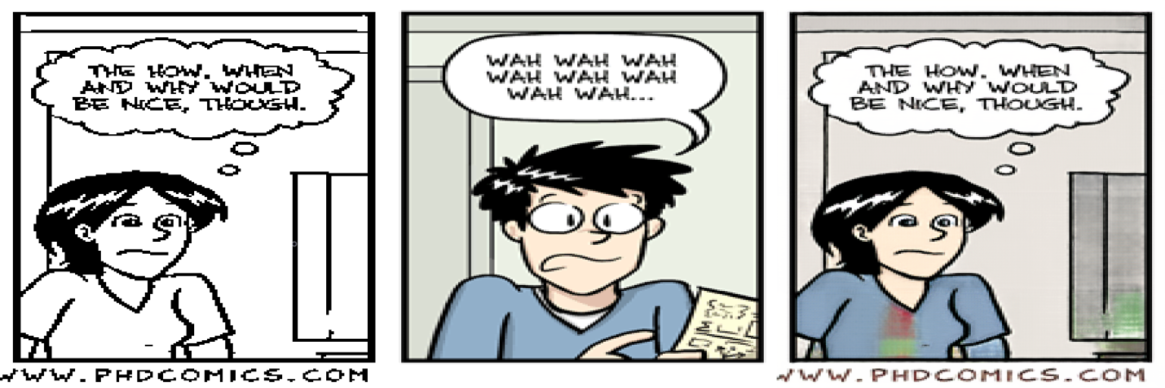
Network – first round training
line-art reference image output ground truth
It works on the scenery which is similar to the training set
It really transfers the color instead of ignoring the reference image!

Slide 21
line-art reference image output ground truth

Slide 22
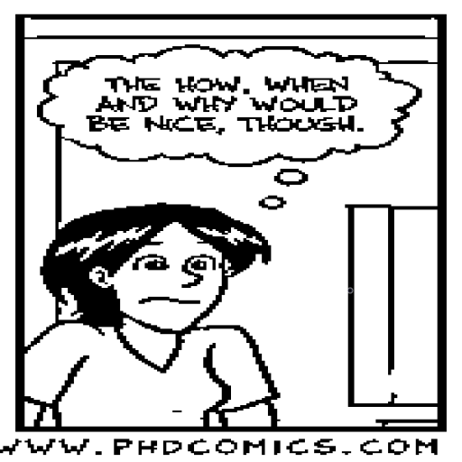
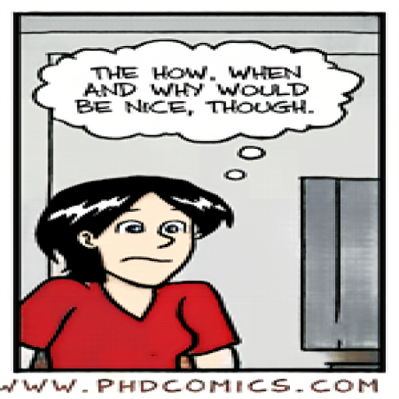
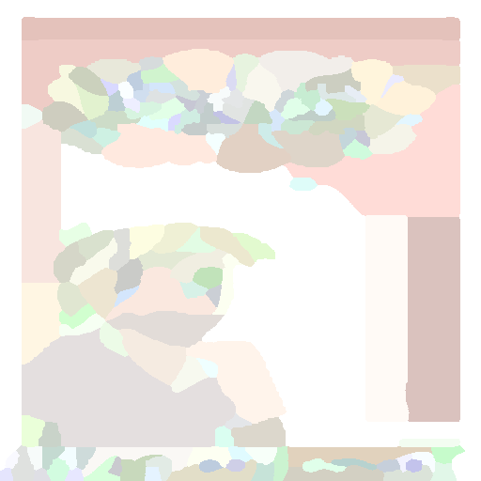
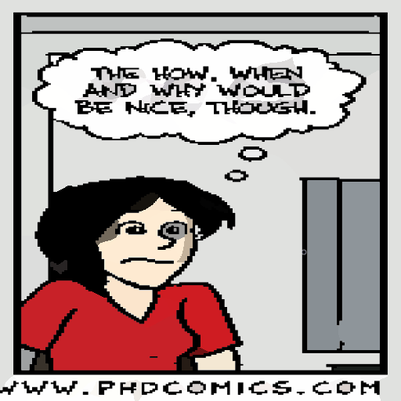
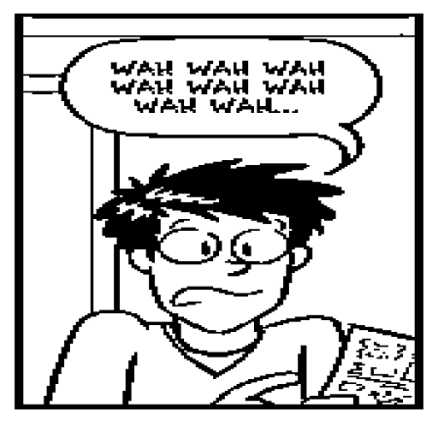
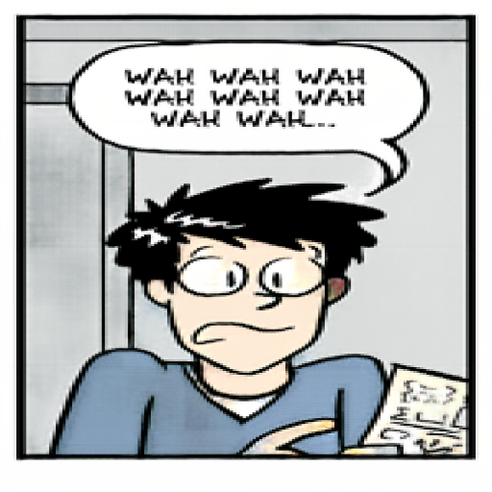
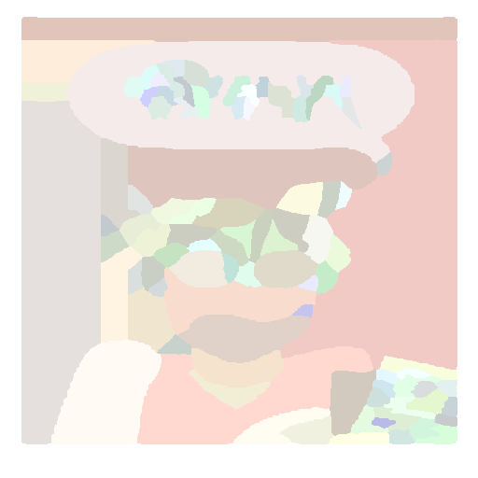
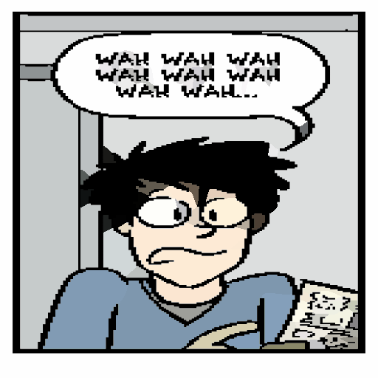
Network – first round training
line-art color image regions current result ground truth

Slide 23
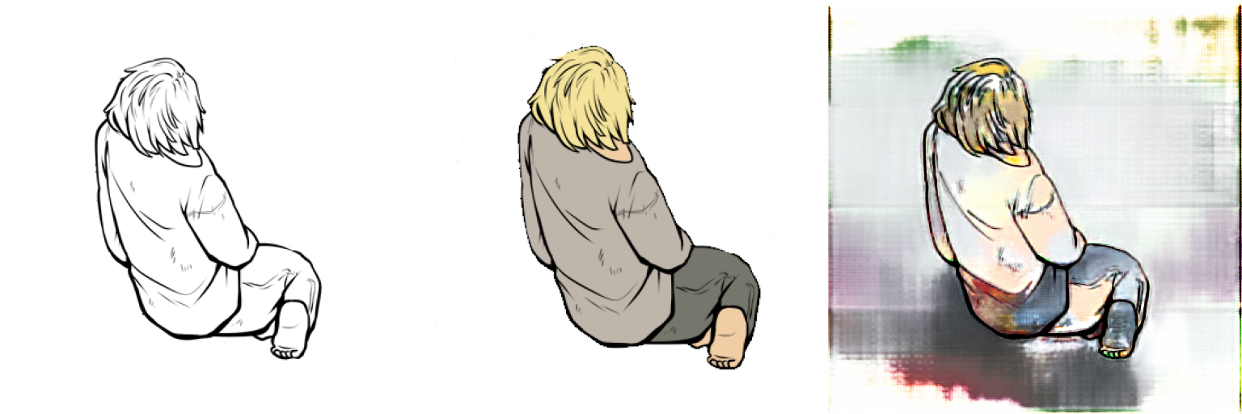
Network – first round training
The network gets confused with the line-arts which have different styles from the training set.
(e.g. a scenery which contains only a character; the thickness of line is different from the training images.)
We need to enlarge our dataset!

Slide 24
Content
Intro
Method
Our work
Next steps

Slide 25
Next steps
1. Find other comics and enlarge the dataset.
2. Get the images by randomly cropping instead of resizing.
*3. Adapt the structure and the hyperparameters of the network.
4. Find other ways to use GMIC.
*5. Optimize the Closure of Strokes algorithm.

Slide 26
Questions?
Intro
GMIC (stroke closing algorithm)
Network
Current work
Next steps

